Slide 1

Bye Bye Diapers!
Potty Training 101
Beth Monighan, B.S.
Developmental Evaluation Coordinator
Amanda Beamer, OTR/L
Occupational Therapist
UPMC Infant Development Program

Slide 2
Training Objectives:
Parents and caregivers will better understand how children must learn to coordinate an equally complex combination of physical and cognitive tasks in order to master using the toilet.
Understand what physical, emotional, cognitive and communication skills help support the process of toilet training.
Understand the impact of sensory processing with potty training
Parents and caregivers will recognize individual readiness signs in children.
Know how and when to begin the process of toilet training based upon the child’s unique abilities and temperament.
Learn practical tips for aiding young children in transitioning out of diapers

Slide 3
Potty Training
During the toilet-training process, your child must learn to coordinate an equally complex combination of physical and cognitive tasks. While it isn’t necessary to wait until you’re sure that every one of these developments is in place, each skill learned and emotional stage met increases the chances of toilet-training success.
This is a process that involves the body and the mind.
There is no right or wrong age to start.
Depends on the family and the child’s readiness

Slide 4
Typical Ages that Potty Training Starts:
According to the American Pediatric Association…
Readiness skills start between 18-months to 2 ½ year’s of age
On average, potty training begins between 2 and 3 years of age.
Most children are bowel and bladder trained by 4 years of age.

Slide 5
Developmental Skills that Support Success with Toilet Training:

Slide 6
Physiological Skills:
Physiological skills that impact toilet training are the bowel and bladder control skills that a child needs in order to eliminate on a voluntary basis.
Sphincter muscles develop around the age of 12-24 months and allow a child to delay elimination of bowel or bladder for a period of time.
Nighttime bowel control is first achieved followed by daytime bowel and bladder control.
Nighttime bladder control is the last to develop
**Just because a child has the physiological readiness skills for toilet training that does not mean that they are ready for potty training. Cognitive, motor, communication and social emotional skills are also required for toilet training success.

Slide 7
How will you know that your child’s physiological skills are mature enough for potty training?
Your child’s behavior and actions will tell you!
They will recognize they have a full bladder or rectum which is observable by grunting when having a bowel movement.
They will pull at their diaper when urinating
They will squat or hide when eliminating
Regularity in bowel movements and no bowel movements at night
Dry diapers when your child wakes from naps and night sleep
More quantity of urine at one time, not just small amounts frequently

Slide 8
Motor Skills:
Potty training requires fine motor and gross motor skills.
Fine Motor Skills:
Grip strength
Finger prehension
Coordination of hands and arms
Gross Motor:
Trunk Stability
Walk Independently
Sit independently
Stand independently and
maintain balance during
movement

Slide 9
How will I know when my child’s motor skills are mature
enough for toilet training?
Child can sit on the potty without falling off
Can undress themselves (pull down pants)
Can dress themselves (pull up pants)
Can get to the potty independently

Slide 10
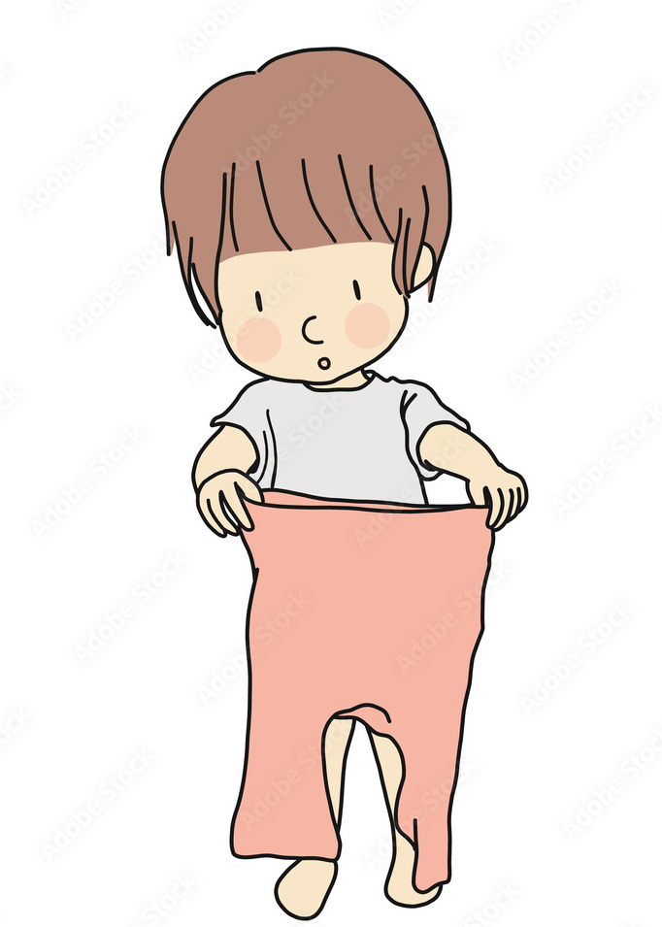
How to Dress for Success:
Elastic Waistbands: Allow your child to easily pull their pants up and down
Loose Clothing
Velcro Closures: Easier than snaps and buttons
Shorter Shirts that will not get in the way during toileting or tuck their shirt in the neck hole of the shirt.
Go Bare: Offer the potty when your child is not wearing clothing (before bath, clothing changes)
Avoid overalls, zippers, buttons, snaps, jumpsuits, tights

Slide 11
Sensory Processing Skills:
Sensory processing skills are the skills that children use to gather information about their environment and how they react to that sensory experience. Sensory input must be detected by the body, the brain must integrate the sensory the experience and decide how to react. Some children have difficulty reacting appropriately to the sensory experience.
Under-Reactive-May not notice sensory experiences
Over-Reactive-May over react to sensory experiences and have an extreme reaction
Seekers-Want more sensory input than other children
Avoiders-Avoid sensory input
**When children have difficulty with sensory processing skills potty training can be difficult.

Slide 12
Sensory Processing Skills Needed for Potty Training:
Interoception-Be aware of body’s signals
Recognize when bladder and bowel are full
Be aware of where their body is in space
Tolerate changes in position
Be able to calm body to sit on the potty until elimination is complete
s

Slide 13
Overcoming Sensory Challenges during Potty Training:
Over-Reactive Children:
Provide a footstool for feet
Use a small toilet seat over the large toilet seat
Allow movement breaks before potty time
Play relaxing music in the potty area
Hold a pleasant sent by the child’s nose
Cover automatic toilet flushers in the community with a post it note
Close the lid of the toilet prior to flushing
Use soft toilet paper or wipes
Wear soft clothing without seams
Read social stories and potty books about potty training
Minimize extraneous sounds such as the fan
Use of routines to make potty training predictable

Slide 14
Under-Reactive Children:
Encourage deep pressure play to develop body awareness
Intensify the feeling in a dirty diaper (use of cloth diapers, loose clothing)
Use words to describe “potty feelings” (wet, cold, yucky)
Use of food coloring in the toilet
Tummy massage to understand feelings in their tummy
Draw attention to the feeling of “going”
Sensory Seekers:
Offer movement breaks prior to potty time
Set us calming environment
Allow sensory activities while sitting on the potty (play doh,
sensory bins, squishy balls, fidgits)

Slide 15
Cognitive (Thinking) Skills:
How will I know when my child’s cognitive skills are mature enough for toilet training?
Notices what others are doing and imitates actions
Focus, attention and memory to complete a task with several steps
Making Plans and Carrying Them Out
  symbolic thinking (picturing actions)
  problem solving (planning)
  memory (can recall what comes next)

Slide 16
Communication Skills:
How will I know my child’s communication skills re mature enough for toilet training?
Follows 1-2 step related directions
Understands words about using the potty.
Use gestures, pictures/visual aides, actions or words to indicate the desire/need to use the potty.
Understands pictures as symbols - (picture of a toilet, pictures for a sequence of going potty, books about using the potty, etc.).
Indicates an understanding of yes/no – answer using word or gesture.
**Verbal communication isn't entirely necessary before you introduce potty learning!

Slide 17
Social Emotional Skills:
A child’s social emotional readiness for toilet training is the most difficult to recognize-particularly since a child moves in and out of “emotional prime times” and troublesome periods for toilet training throughout early childhood.
Social Emotional Stages that support potty training:
Proud of new skills and accomplishments
Desire to gain parents’ and caregivers’ approval, begins to understand consequences related to their behavior
Social awareness—the observation of and desire to be like others, to mimic or conform to peer’s behavior
Desire for independence-
Self-mastery- motivation that comes from within the child to learn new skills, find joy in facing new or challenging tasks

Slide 18
Social Emotional Skills:
Social Emotional Stages that may make potty training more challenging:
Testing of limits and rules
May develop sudden fears
Frustrates easily
Desires to control others, resists, tests limits
Extreme emotional shifts and contradictory responses

Slide 19
The Impact of Temperament and Personality on Toilet Training:
Consider your child's mood
  What time of day your child is most approachable and cooperative?
  Plan your approach based on this time.
Understand your child's attention span.
  Plan distractions to keep your child comfortable while on the potty.
  Read a book, sing a song, fidget, etc.
Consider your child's frustration level
Consider your child’s emotional state
  Enjoys talking about and sitting/exploring the potty…start to introduce
  Resist sitting/exploring, cries when talked about…wait to introduce

Slide 20
When to Begin Toilet Training:

Slide 21
Toilet (Potty) Training Checklist
Is your child ready to be Potty Trained? Check those that apply to your child.
_____Follows simple directions.
_____Remains dry for at least 2 hours at a time during the day.
_____Dry after nap time.
_____Regular and predictable bowel movements.
(some may have bowel movements every day and some may have them less frequently)
_____Walks to and from the bathroom, pulls down own pants and pulls them up again
_____Seems uncomfortable with soiled or wet diapers
_____Seems interested in the toilet.
_____Has asked to wear grown-up underwear.

Slide 22
If the child does not have most of the skills marked then wait a few weeks or months and refer to the checklist again.
Toilet training is much easier if the child is truly ready to master this skill;
To try to be consistent in the Potty training process, please share with us some information about your child’s and family’s preferences in this process:
What words or gestures does your family use for:
Body parts?Urine? Bowel movements?
2. What strategies have been tried at home? (Example: reading
books, aiming at Cheerios, trying on big kid underwear, sitting
on potty,)
3. Does you child have a special need or circumstance that
needs to be taken into consideration?

Slide 23
How Delays in Development Impact
Potty Training:
▪ Delays in one area of development impact potty training and may delay your child’s readiness to introduce toileting.
▪ Work on the area of need with your child before introducing potty training
▪ Make sure that there is not a medical issue that may be delaying potty training
▪ You may need to learn alternative ways to introduce potty training
▪ Not all potty training methods work for each child. It is an individual process

Slide 24
Potty Training Tips:

Slide 25
Potty Training Tips:
Read & look at books
  Ask questions about using the potty
  Ask them how they feel about potty training
Have positive poop & pee talk.
  Praise them for pooping and peeing.
  Talk about how it is healthy & makes your body feel better.
Help your child to feel this is something you are doing WITH them not TO them.
  Have them help pick out a training potty, or potty seat, and underwear.
Have your child come with you into the bathroom.
Change your child’s diaper/pull-up in the bathroom.
Explore pretend play with potty training. This allows your child to be the teacher.

Slide 26
Potty Training Tips:
Build diaper/underwear free times into the schedule
  Helps to build body awareness
  Helps child understand cause and effect of what his happening in their body.
  Child can visually see what happens during an accident.
Training Potty vs Potty Seat
Prepare yourself for potty training

Slide 27
Potty Training Tips:
-Be consistent
-Maintain a sense of positivity
-Use positive praise
-Be prepared for accidents
-Do not scold or discipline for accidents
-Give your child warnings that potty time is coming to help them prepare
-Know when to take a break from potty training
-Develop potty training routines that are consistent and predictable
-Have your child be a part of the potty training process (pick out their underwear, flush the toilet, put tissue in the toilet)
-Introduce potty training though having your child watch you put poop from their diaper in the toilet
-Introduce sitting on the potty for short periods of time (sing one song then can get up, read one book then can get up) start with clothing on, then work toward no pants

Slide 28
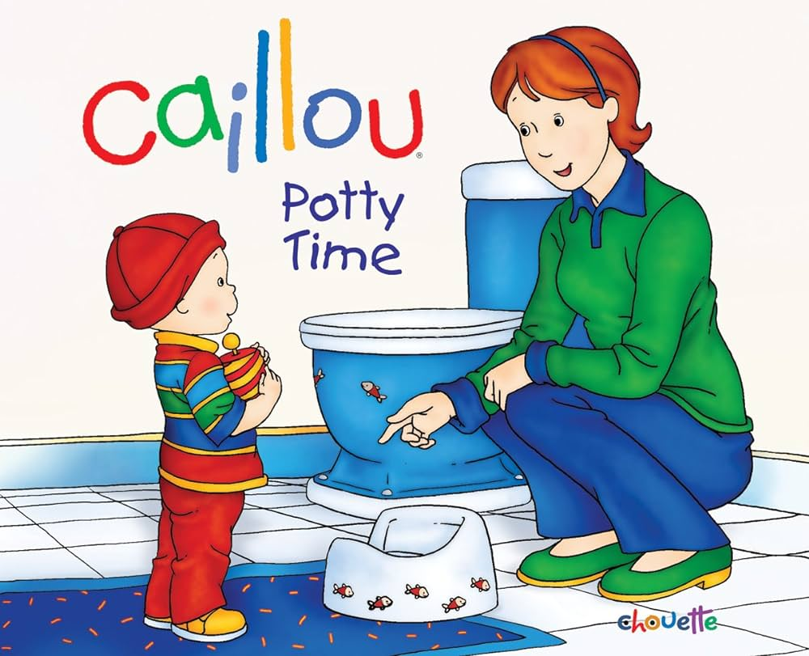

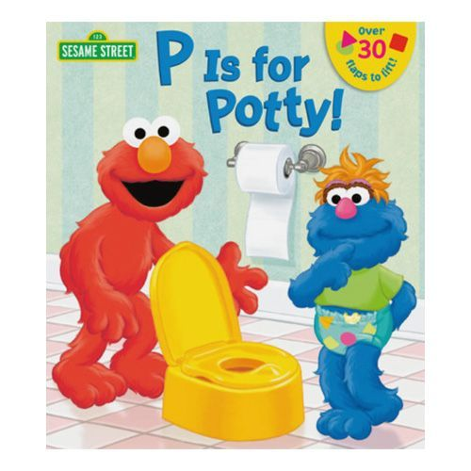


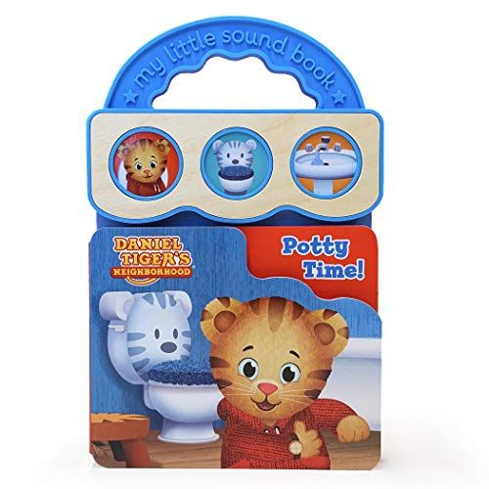
Books to Support Potty Training:

Slide 29
Websites and Apps to Support Potty Training:
https://pbskids.org/apps/daniel-tigers-stop--go-potty.html
https://pbskids.org/apps/daniel-tiger-for-parents.html
www.nncc.org/guidance/toilet.train.html
https://www.pull-ups.com/en-us/resources/training-by-personality

Slide 30
Questions??

Slide 31
Resources: pottytrainingconcepts.com
Henry, Diana, MS, OTR/L, Kane-Wineland, Maureen, PhD, OT/L, Swindman, Susan, OTR/L, BCP. (2007). Tools for Tots: Sensory Strategies for Toddlers and Preschoolers. Glendale, AZ: Henry OT.

